Slide 1
Robotic Seminar
Second meeting 28-Nov
Mingyuan Chi

Slide 2
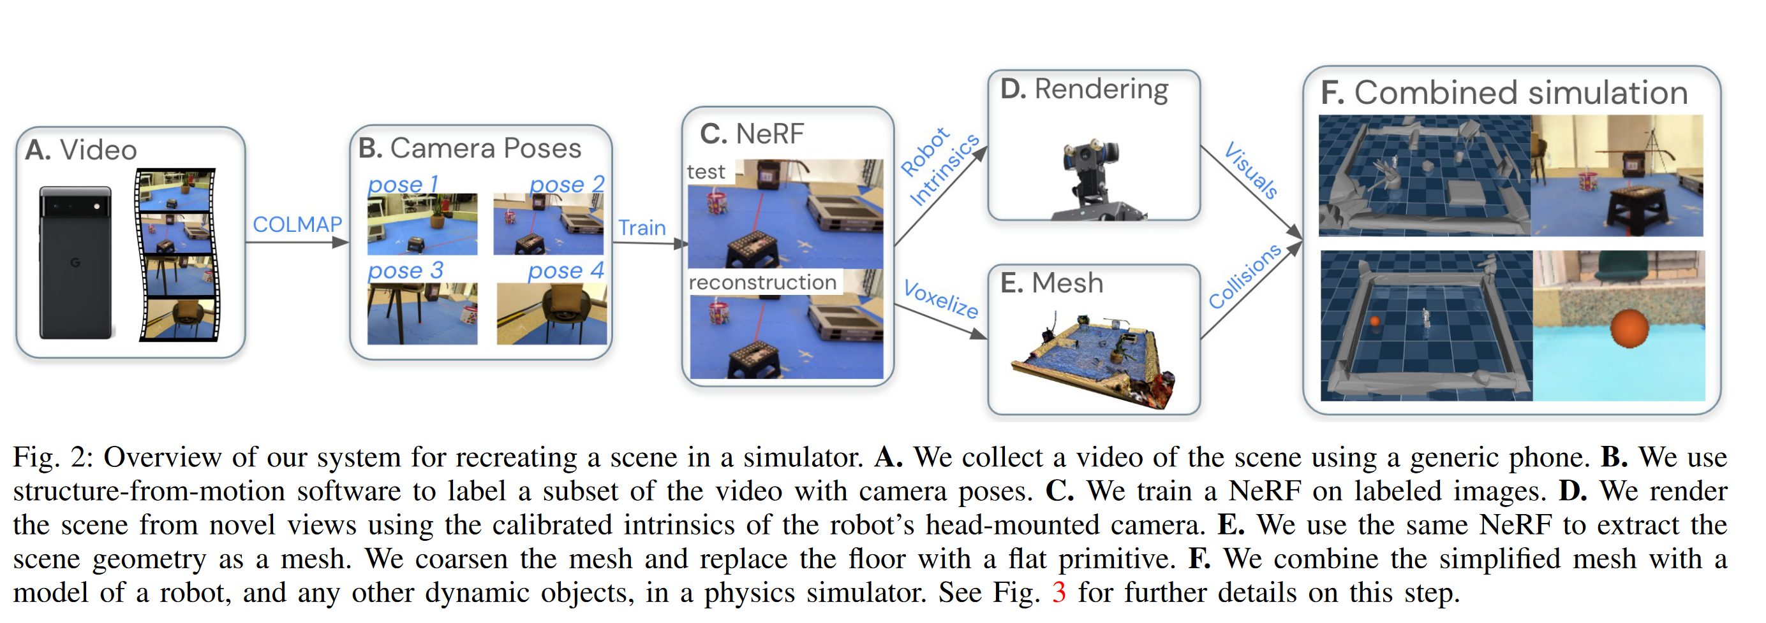
RGB
Neural Field
Nerf2real: Sim2real transfer of vision-guided bipedal motion skills using neural radiance fields
Sensor : Camera(Phone)

Slide 3
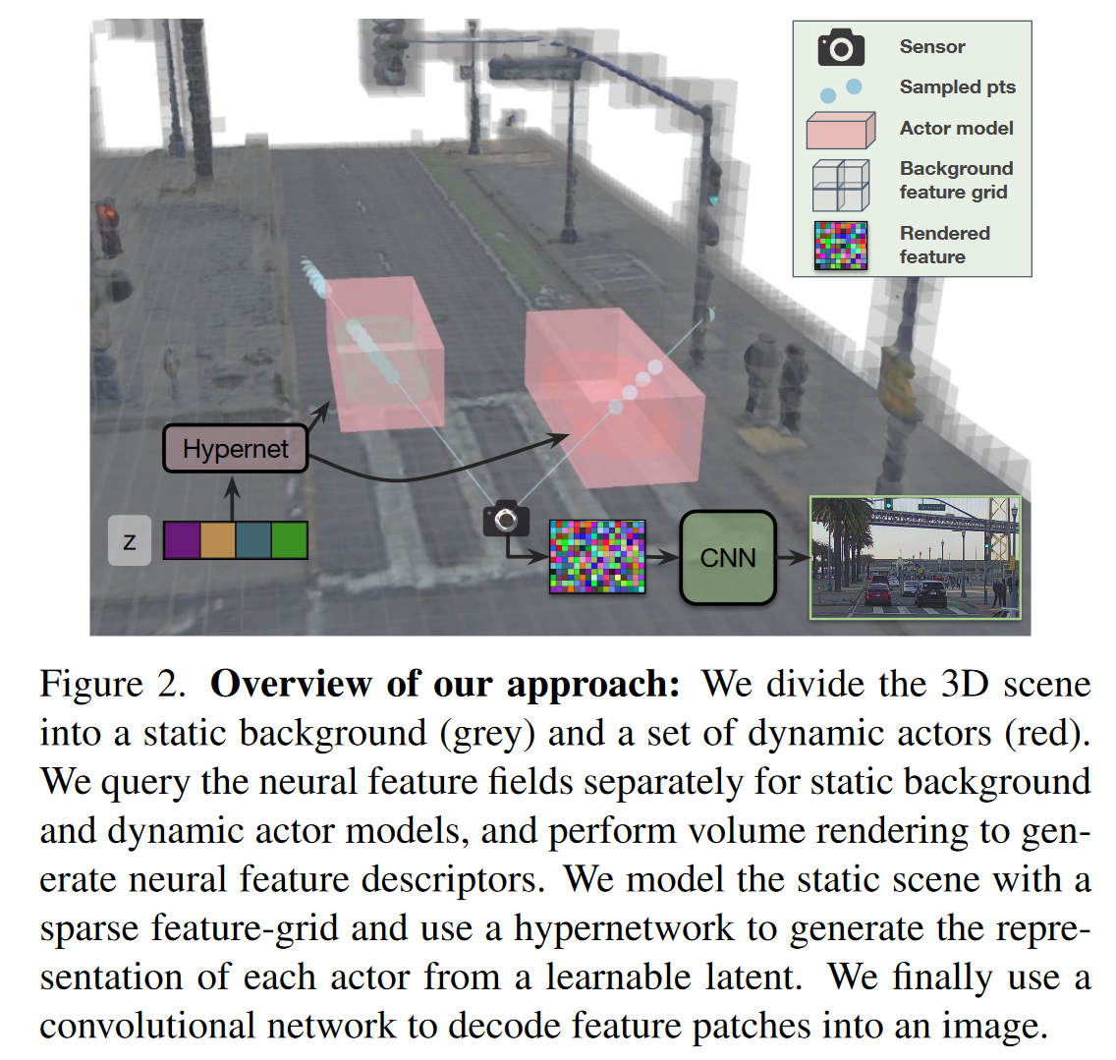
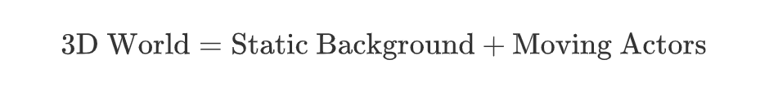
RGB
Neural Field
UniSim: A Neural Closed-Loop Sensor Simulator
Sensor : Camera & LiDAR

Slide 4
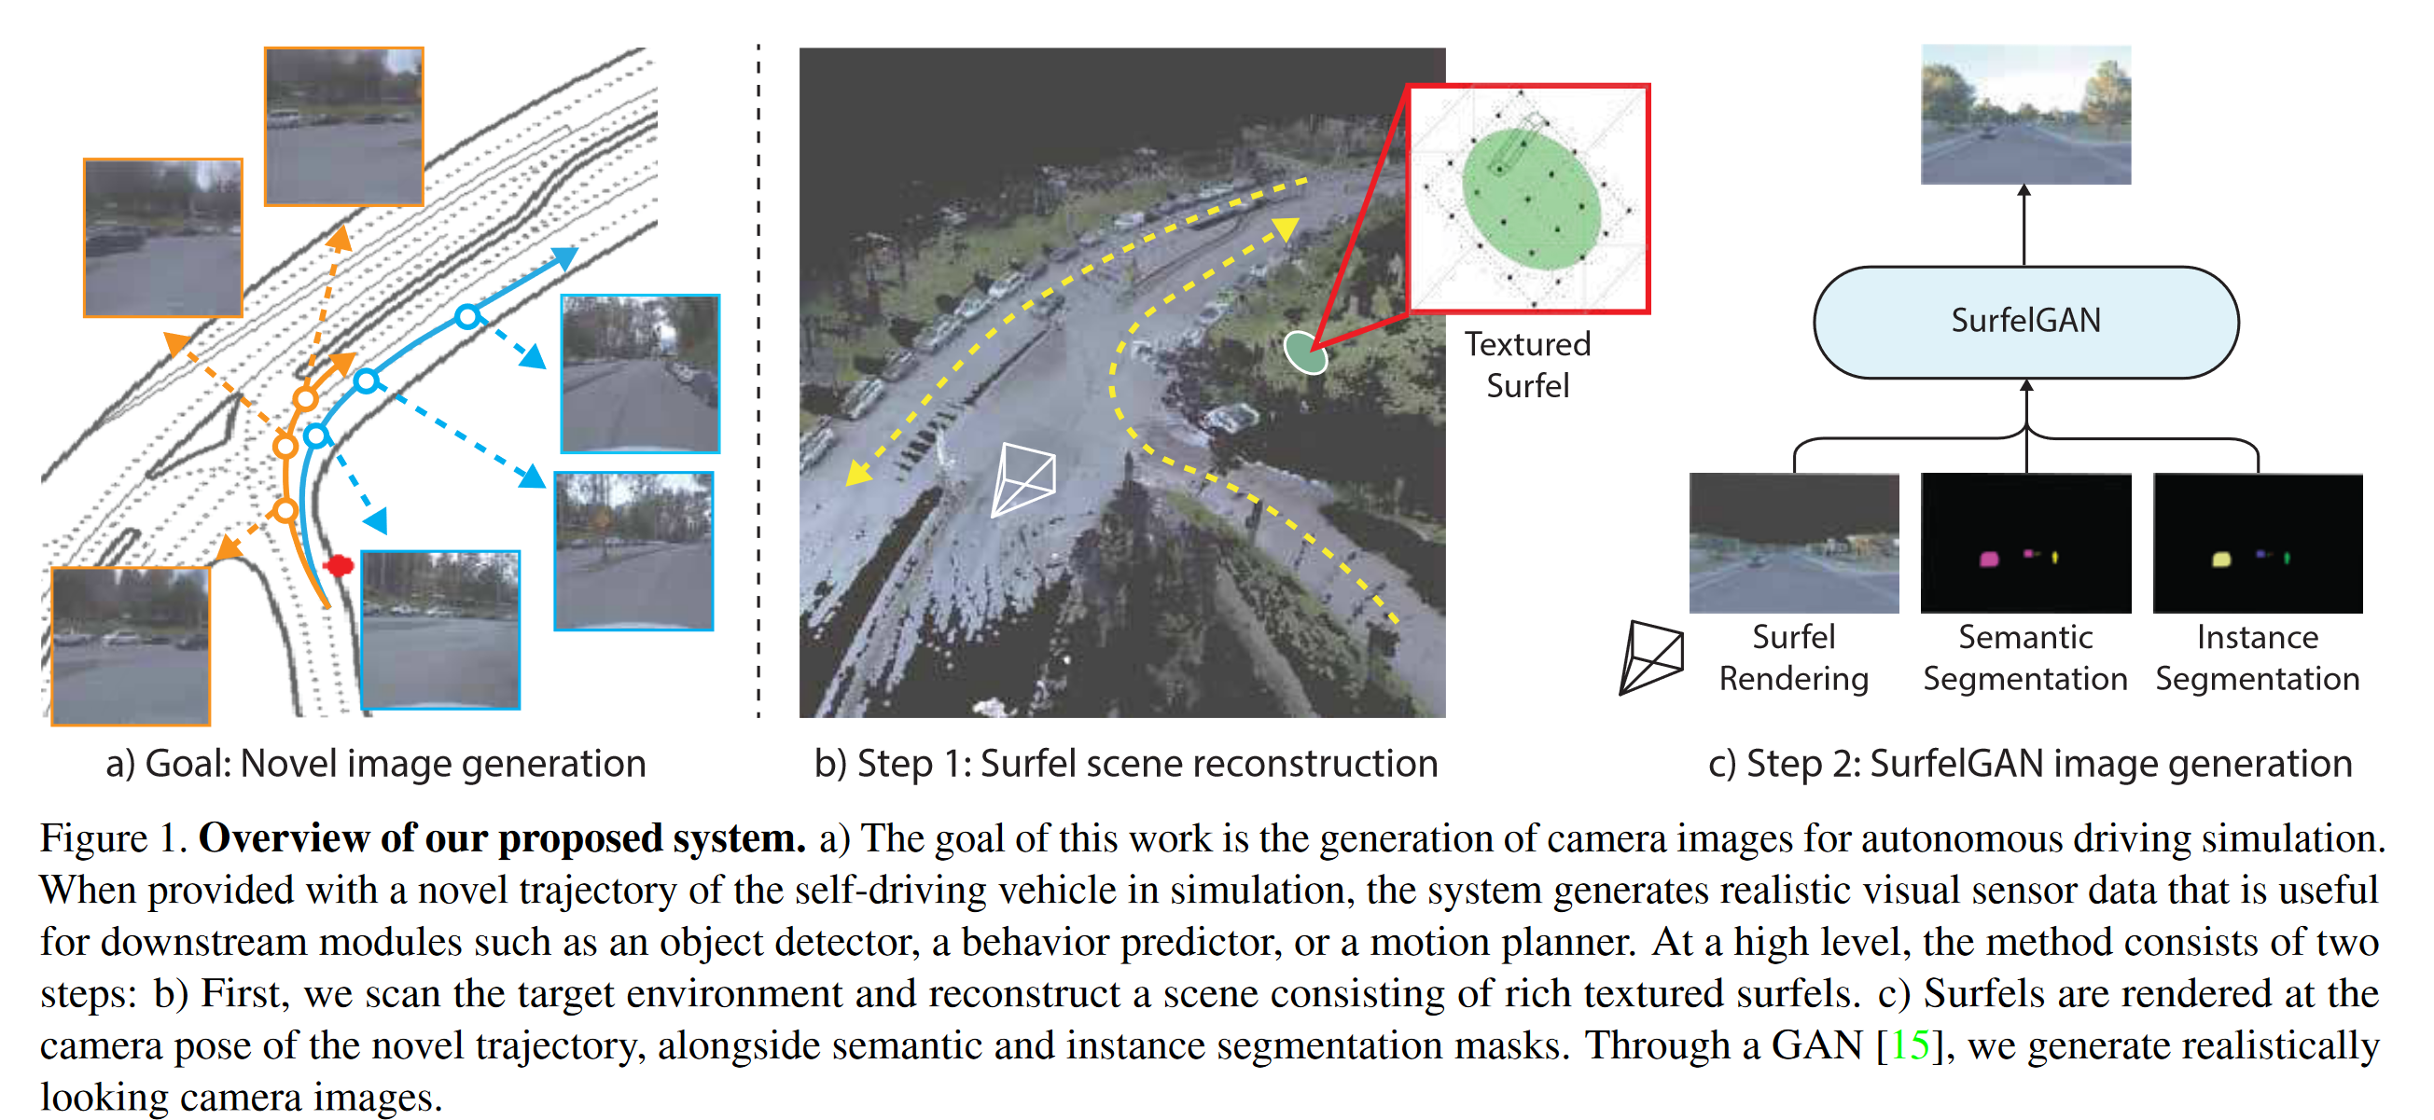
RGB
Synthetic Dataset
SurfelGAN: Synthesizing Realistic Sensor Data for Autonomous Driving
Sensor: Camera & LiDAR
Purpose : Generate
realistically looking
camera images (Texture)
Method :

Slide 5
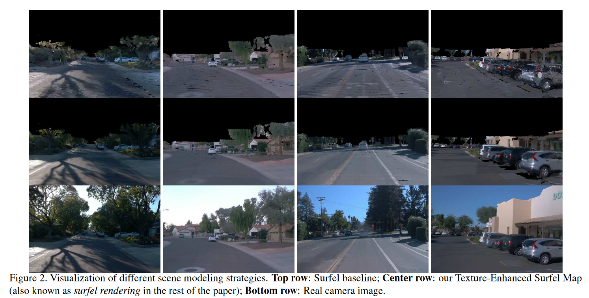
RGB
Synthetic Dataset
SurfelGAN: Synthesizing Realistic Sensor Data for Autonomous Driving
Surfel : A surfel is a small,
oriented disk used to
represent a portion of a
3D surface.

Slide 6
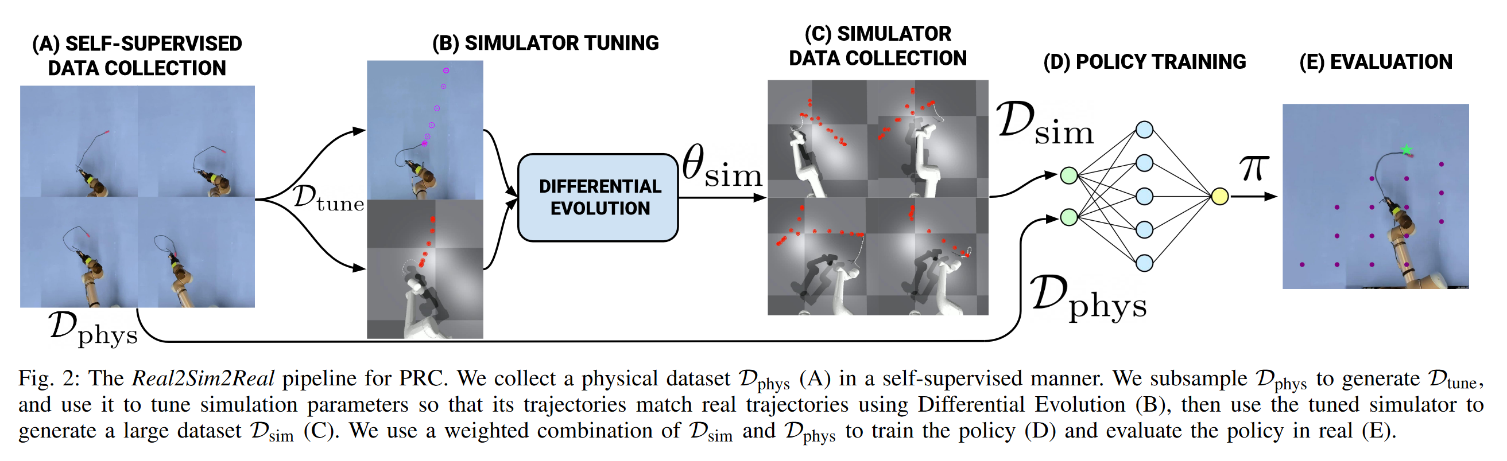
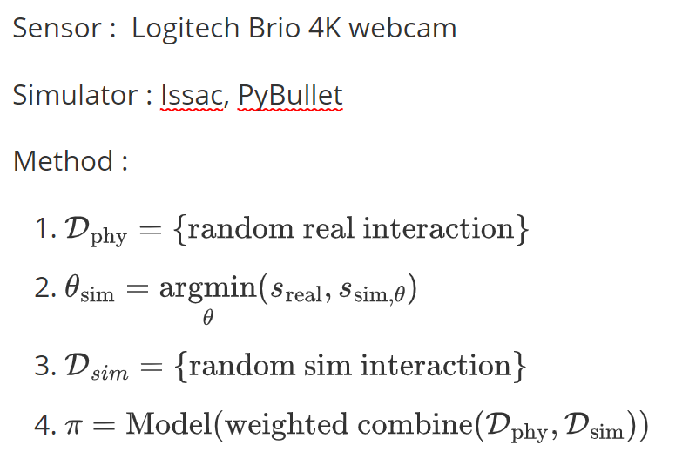
RGB
Synthetic Dataset
Real2Sim2Real: Self-Supervised Learning of Physical Single-Step Dynamic Actions for Planar Robot Casting
PRC : Planar Robot Casting

Slide 7
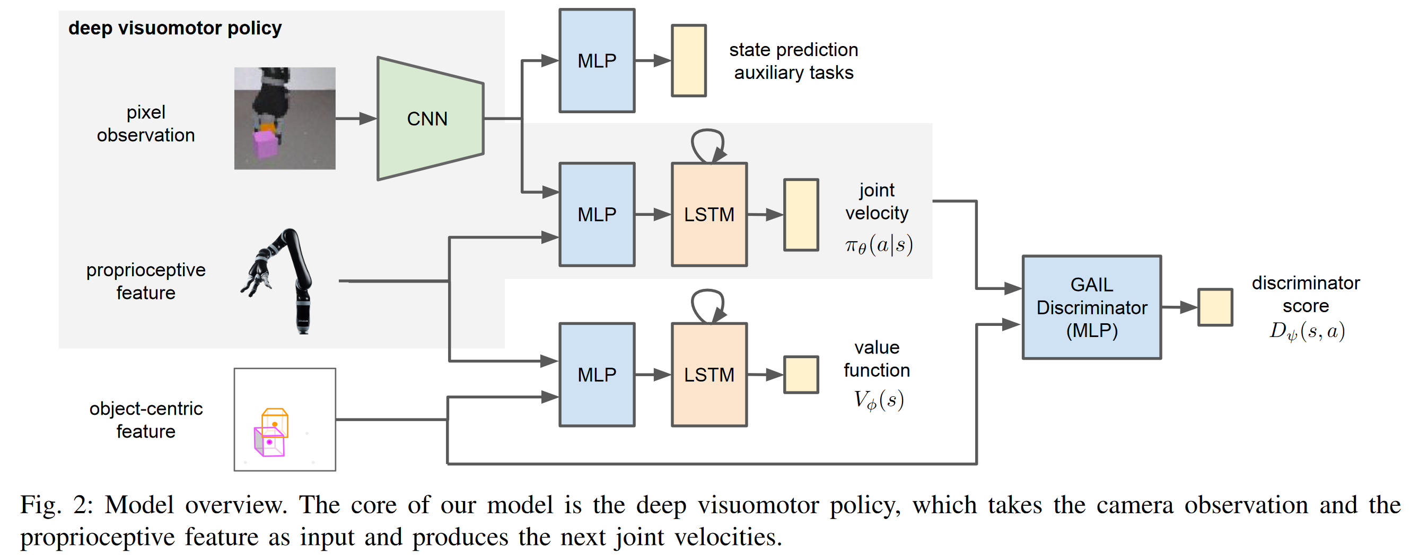
RGB
Simulation Manually Adjusted
Reinforcement and Imitation Learning for Diverse Visuomotor Skills
a Kinect camera (RGBD) was visually calibrated to match the position and orientation of the simulated camera, and the simulation’s dynamics parameters were manually adjusted to match the dynamics of the real arm.
GAIL : Generative Adversarial Imitation Learning

Slide 8
Depth
Sensors
LiDAR : determining ranges by targeting an object or a surface with a laser and measuring the time for the reflected light to return to the receiver .
Kinect : the motion sensing device for the Xbox 360 gaming console. It provides RGB, Infra-Red (IR), depth, skeleton, and audio streams to an application.

Slide 9
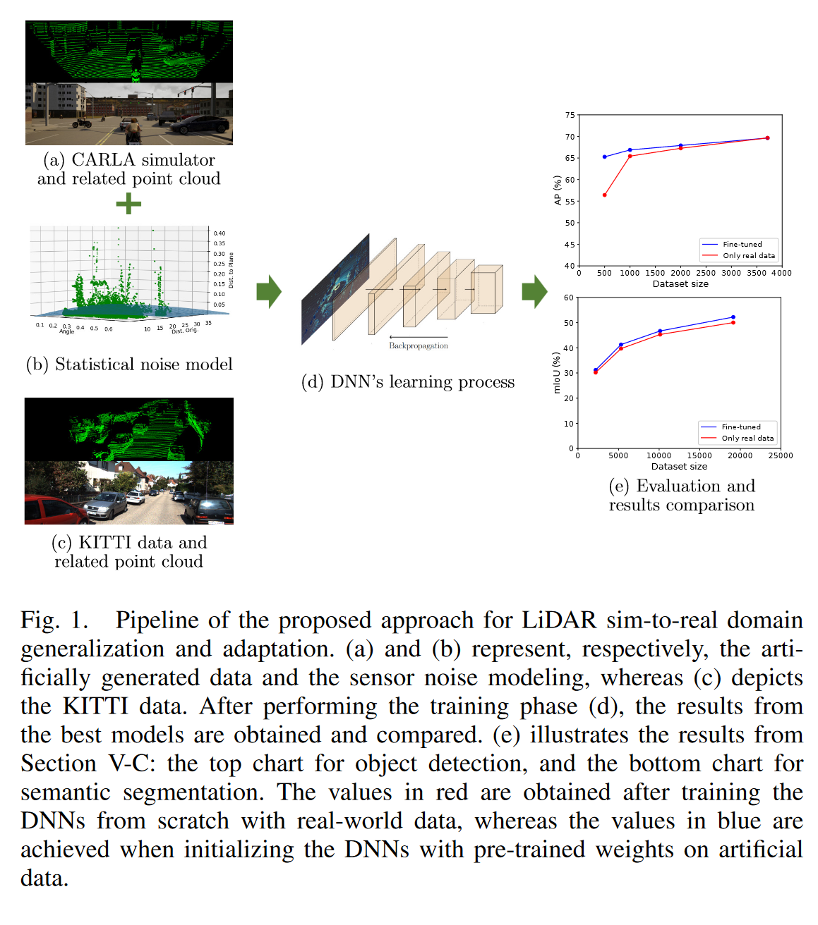
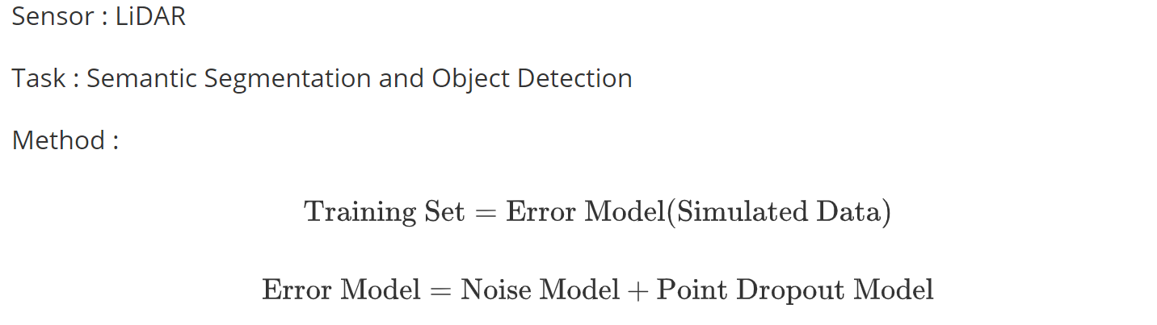
Depth
Domain Randomization
LiDAR Data Noise Models and Methodology for Sim-to-Real Domain Generalization and Adaptation in Autonomous Driving Perception

Slide 10
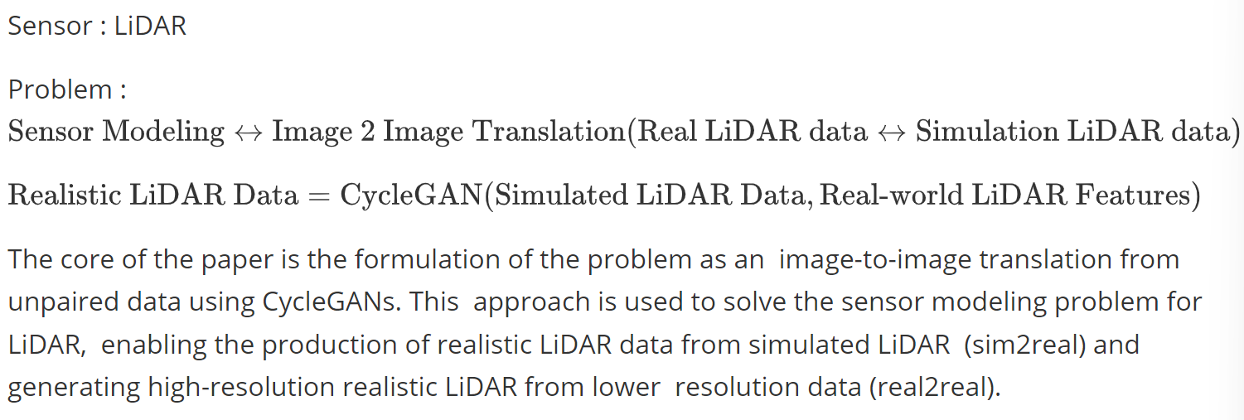
Depth
Realistic Simulation
LiDAR Sensor modeling and Data augmentation with GANs for Autonomous driving

Slide 11
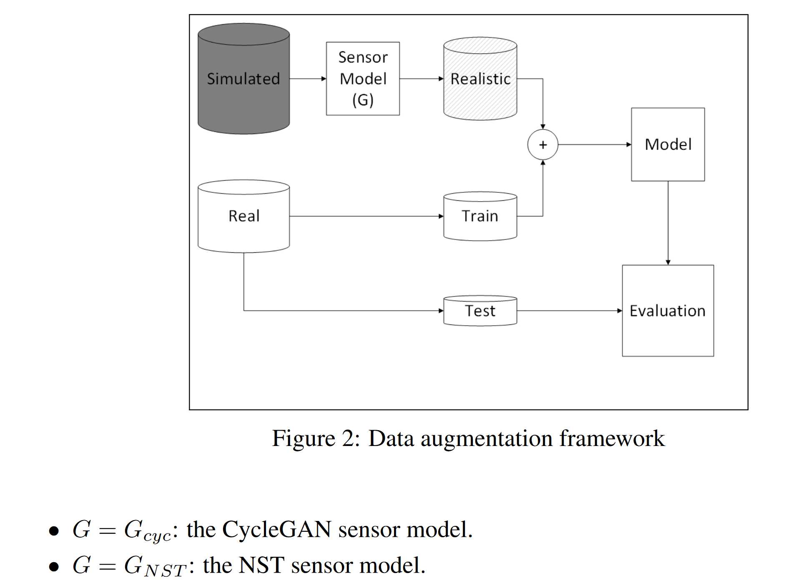
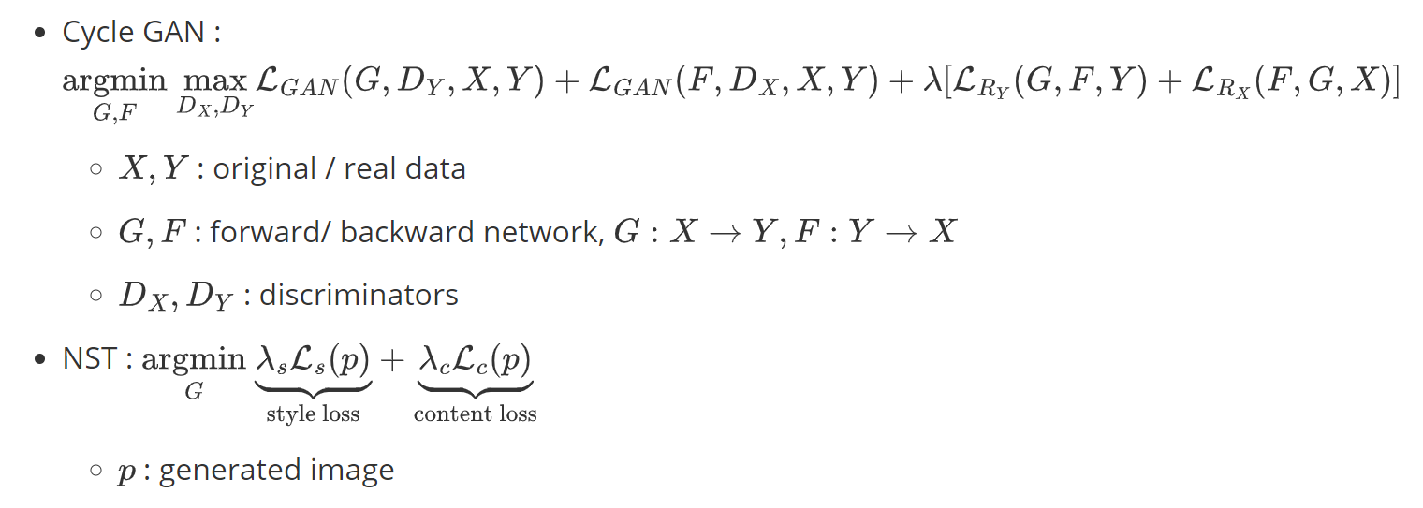
Depth
Data Augmentation
Unsupervised Neural Sensor Models for Synthetic LiDAR Data Augmentation

Slide 12
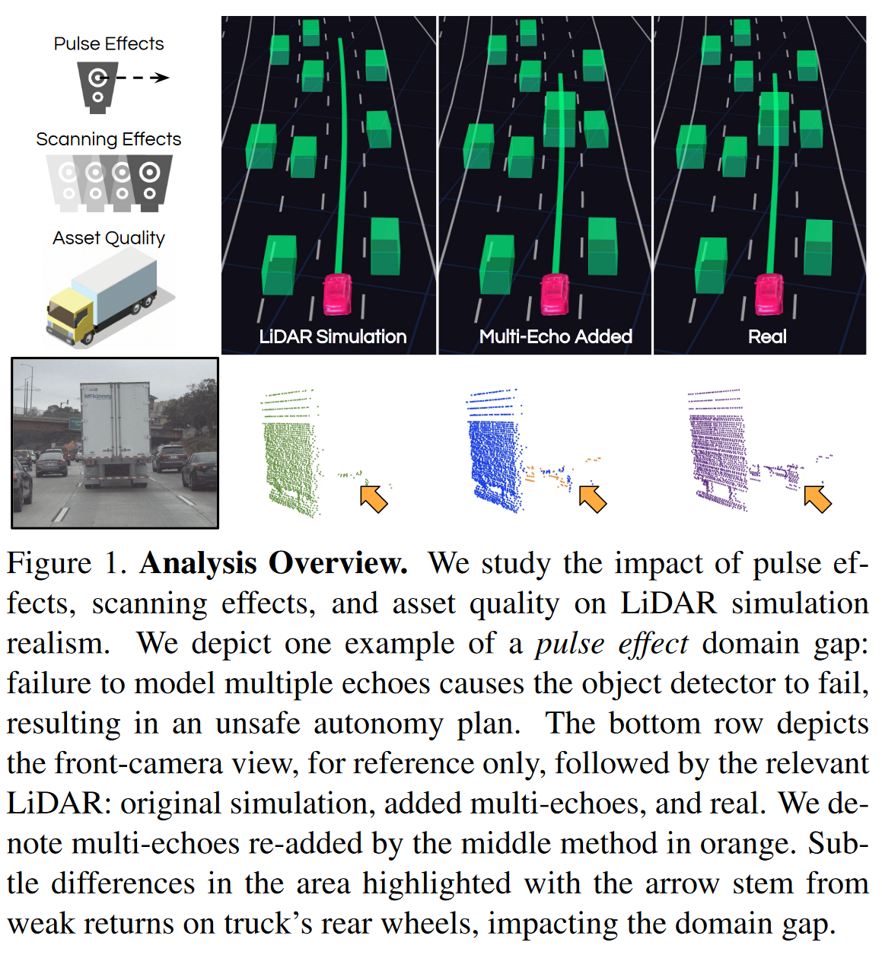
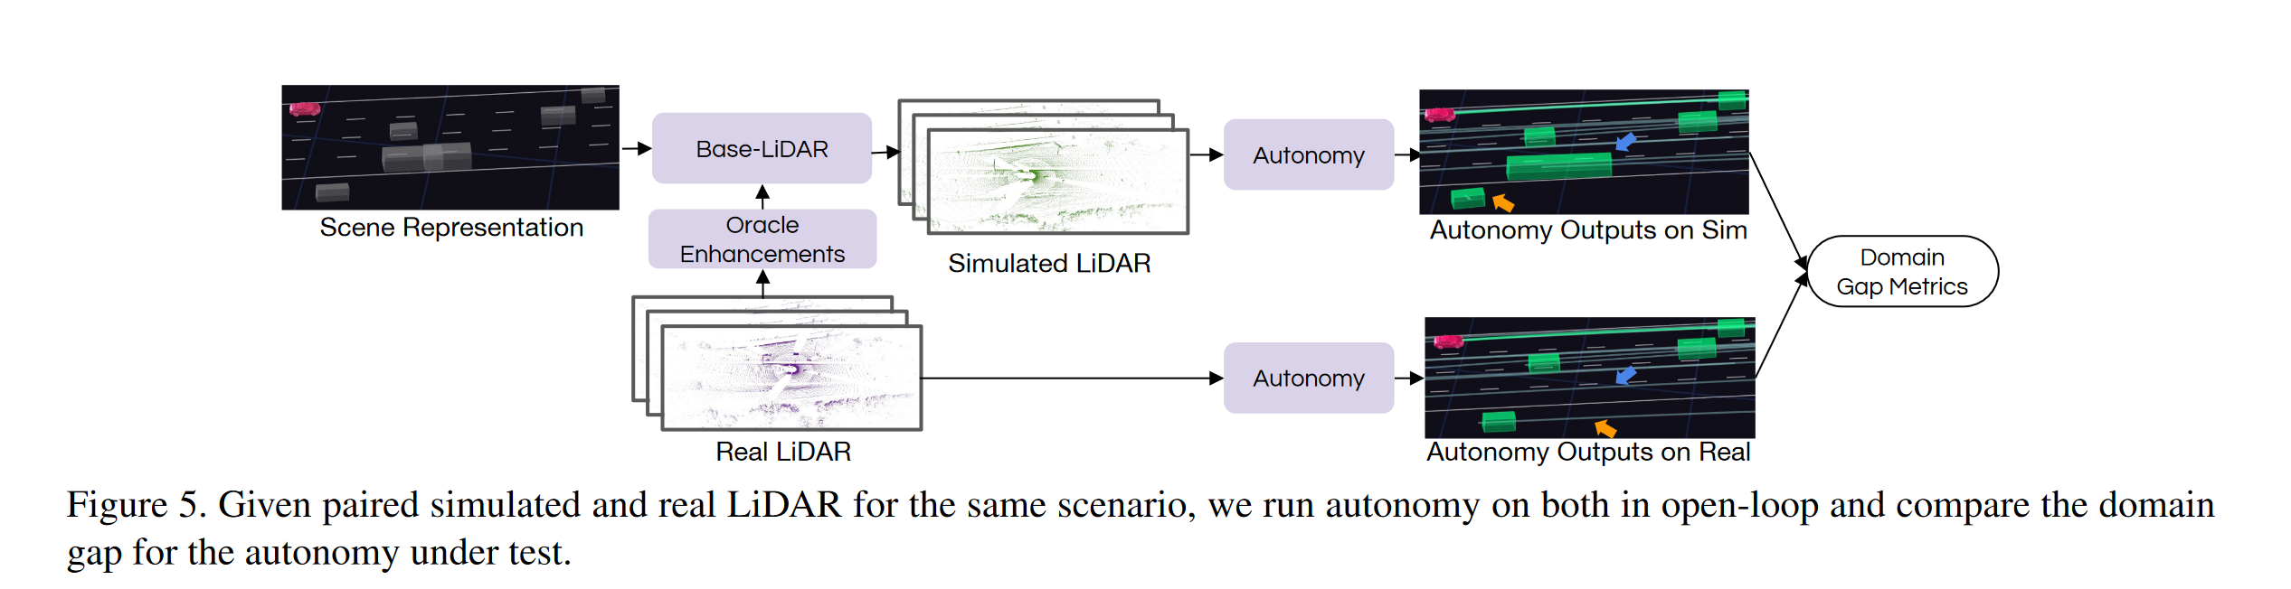
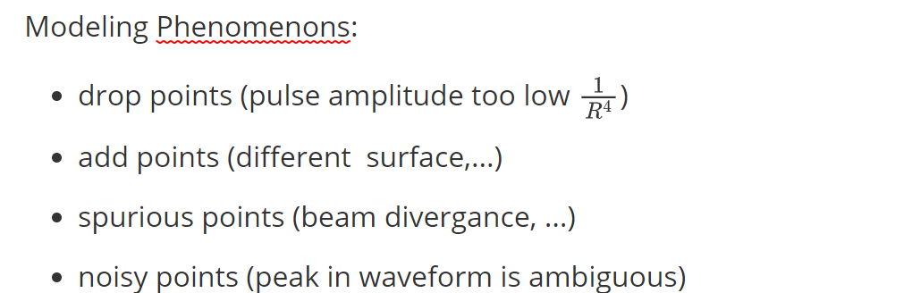
Depth
Simulation Enhancement
Towards Zero Domain Gap: A Comprehensive Study of Realistic LiDAR Simulation for Autonomy Testing

Slide 13
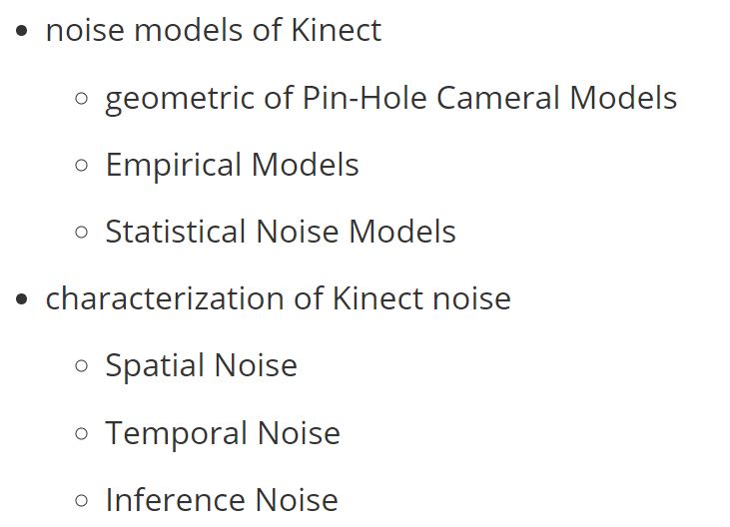
Depth
Kinect Survey
Characterizations of Noise in Kinect Depth Images: A Review

Slide 14
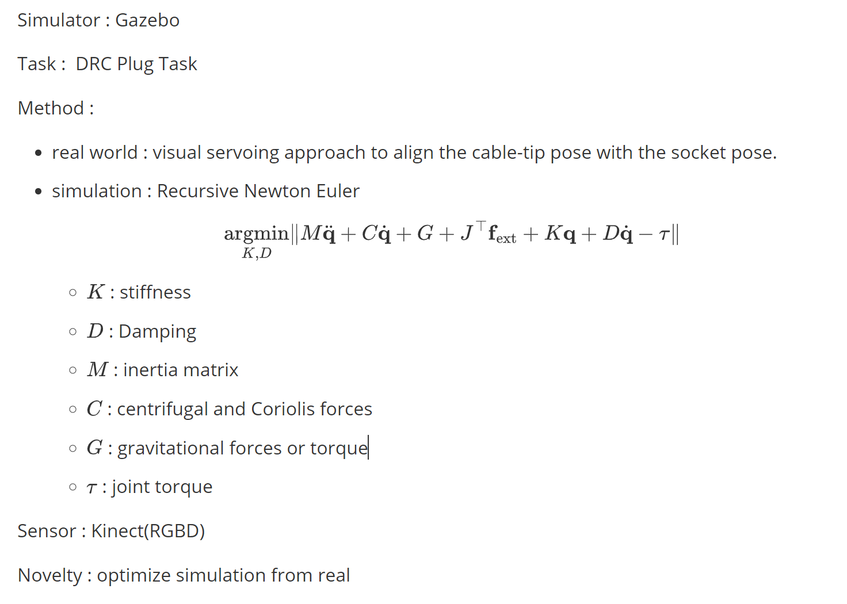
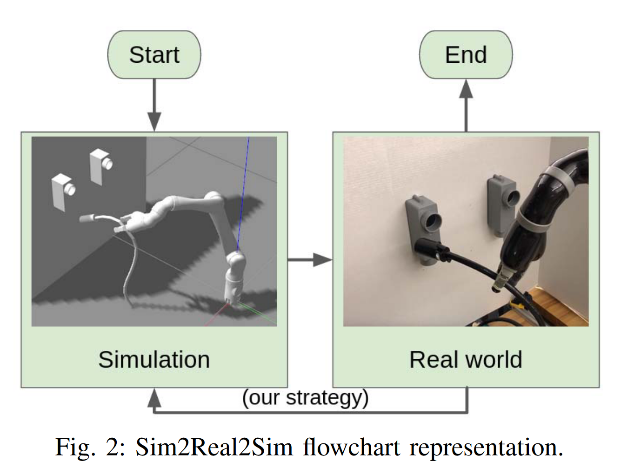
Depth
Realistic Simulation
Sim2Real2Sim: Bridging the Gap Between Simulation and Real-World in Flexible Object Manipulation

Slide 15
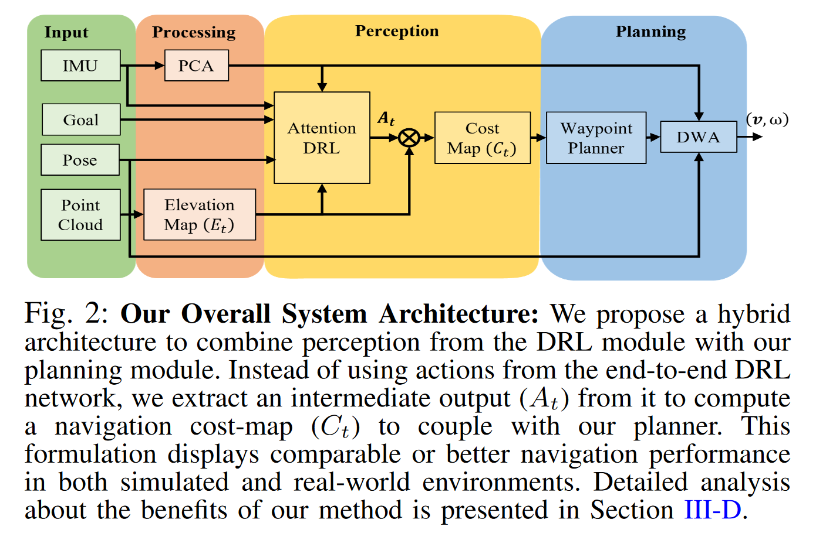
IMU
Policy Modal
Sim-to-Real Strategy for Spatially Aware Robot Navigation in Uneven Outdoor Environment
point cloud is gained from LiDAR
DWA: Dynamic Window Approach to penalize velocities that could cause robot flip-overs
IMU is processed by PCA

Slide 16
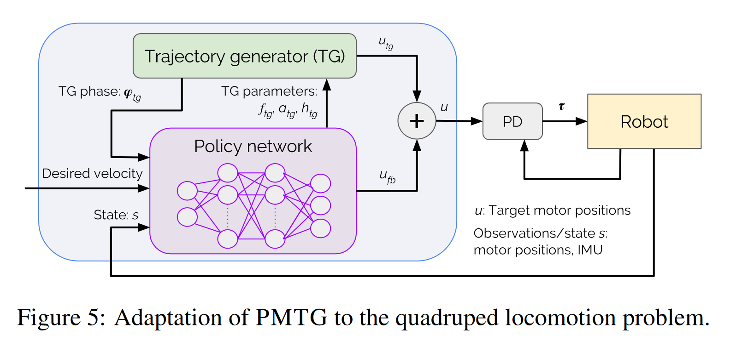
IMU
Policy Modal
Policies Modulating Trajectory Generators
IMU as modal for policy

Slide 17
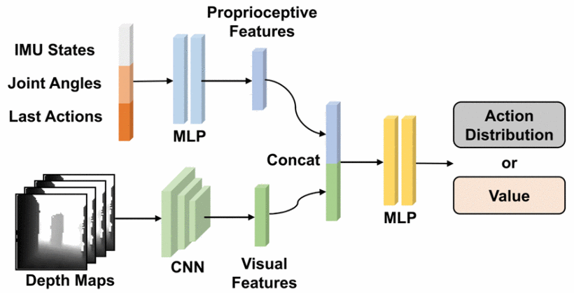
IMU
Policy Modal
Sim-to-Real Strategy for Spatially Aware Robot Navigation in Uneven Outdoor Environment
IMU as modal input for policy

Slide 18
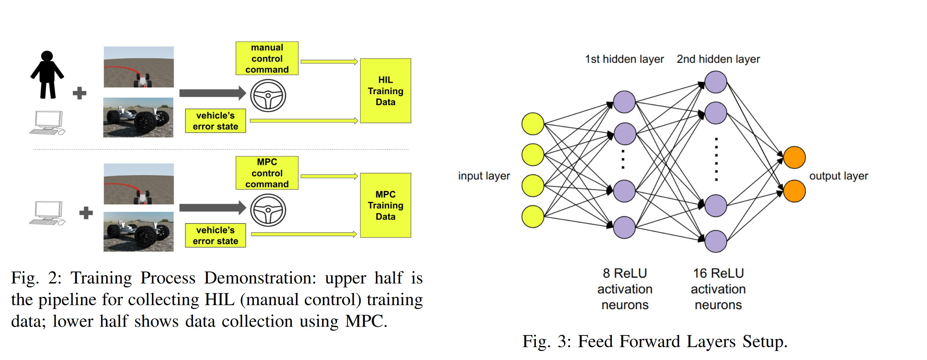
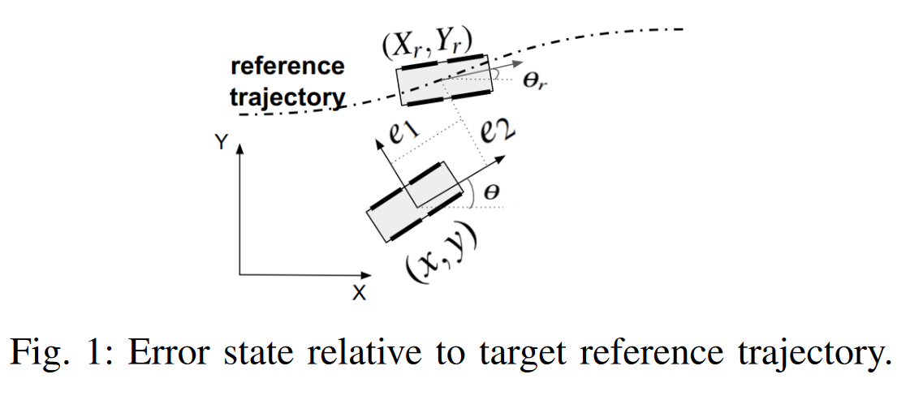
IMU
Error Esimation
Zero-Shot Policy Transferability for the Control of a Scale Autonomous Vehicle
IMU for error estimation

Slide 19
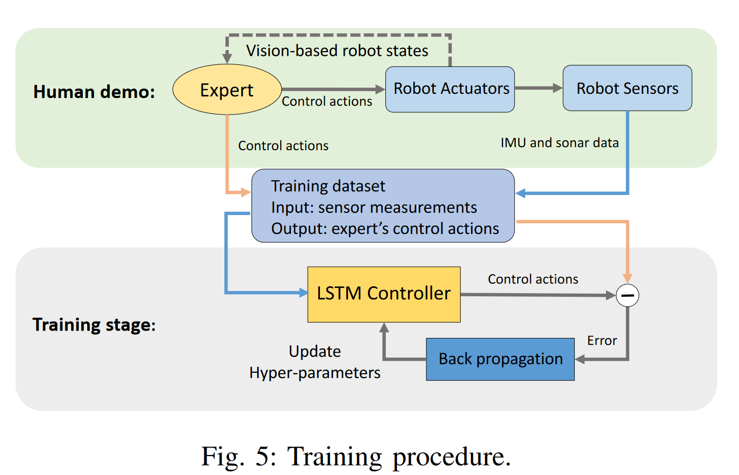
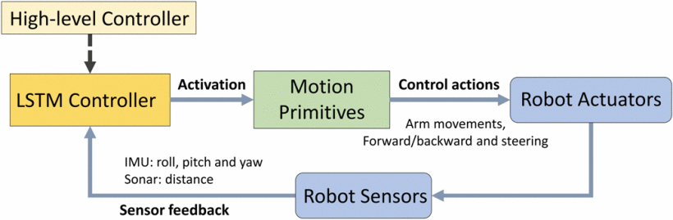
IMU
Controller Modal
Learning Autonomous Mobility Using Real Demonstration Data)
Time sequence IMU modeling with NN

Slide 20
Force Sensor
Review
Robotic tactile perception of object properties: A review
Single-point contact sensor :
measure contact force : ATI Nano 17 force-torque sensor
measure vibration : biomimeticwhiskers
Tactile Array: fiber optics, MEMS barometers, RoboTouch, DigiTacts
optical tactile sensor, high resolution : GelSight, GelTip, TacTip, DIGIT

Slide 21
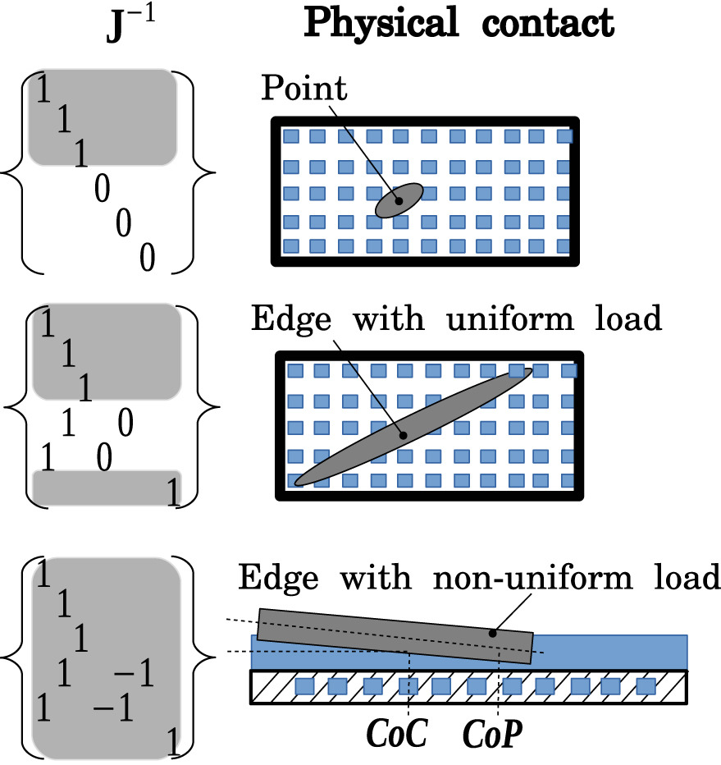
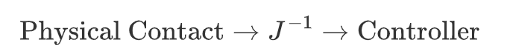
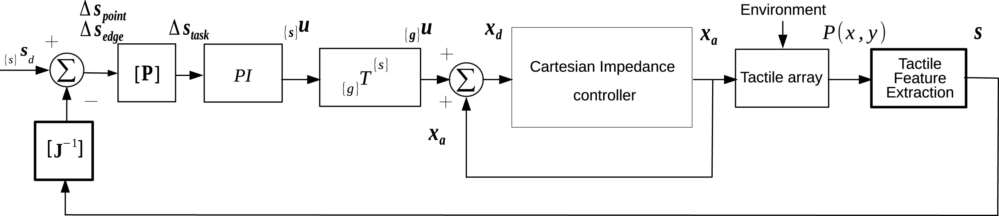
Force Sensor
Jacobian feed forward
Touch driven controller and tactile features for physical interactions

Slide 22
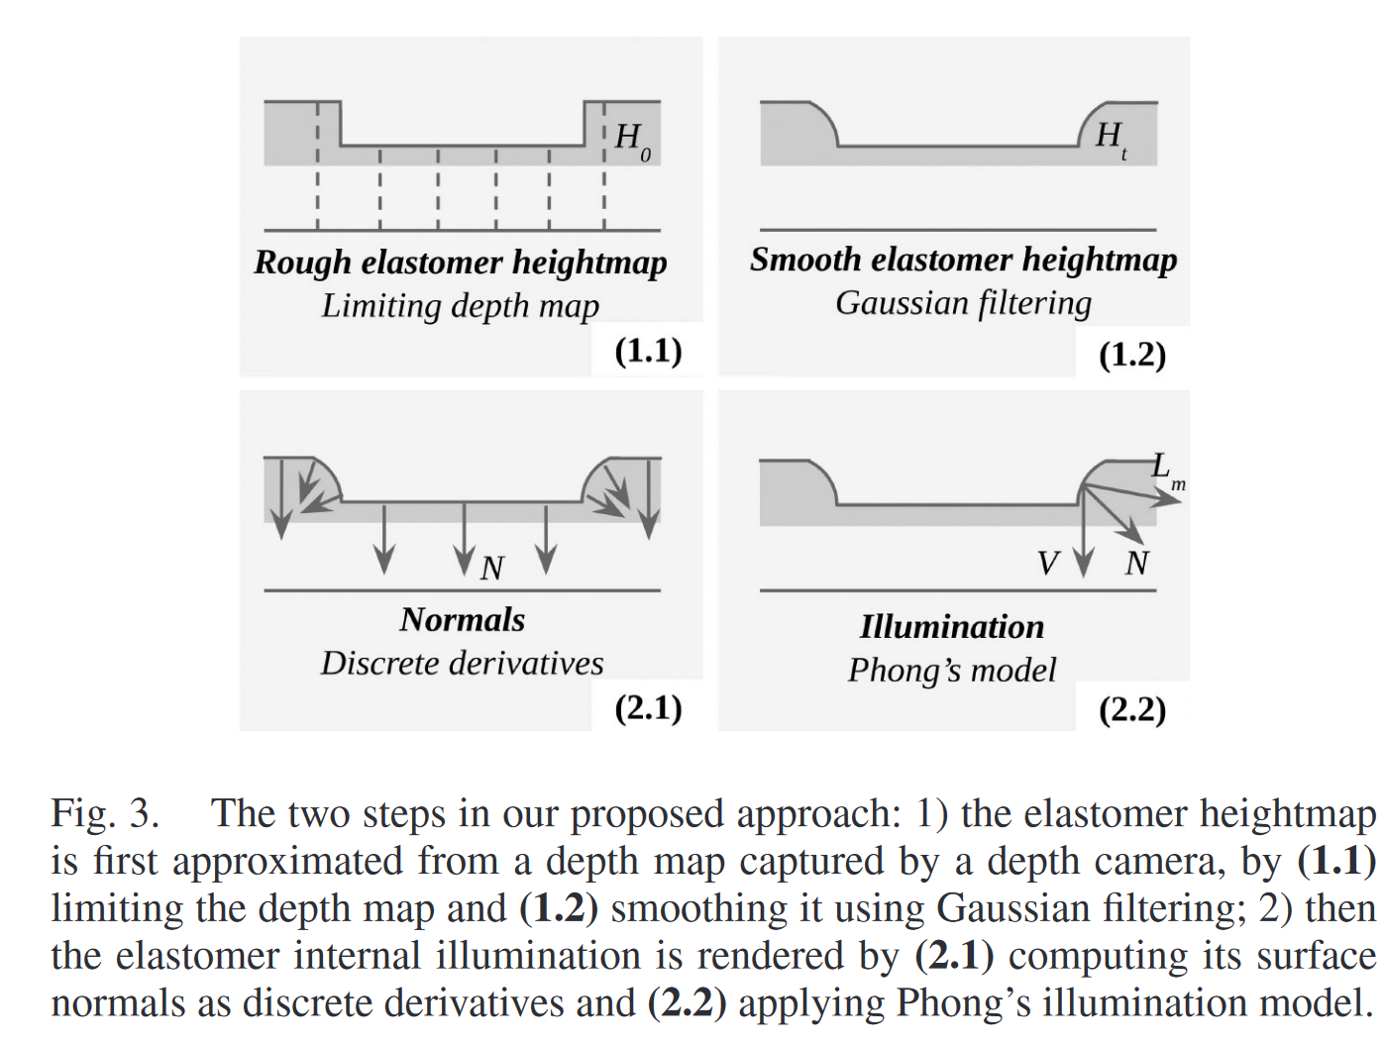
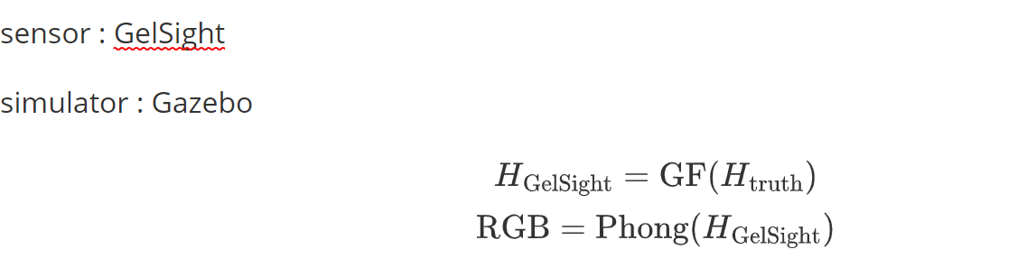
Force Sensor
Simulation Enhancement
Generation of GelSight Tactile Images for Sim2Real Learning

Slide 23
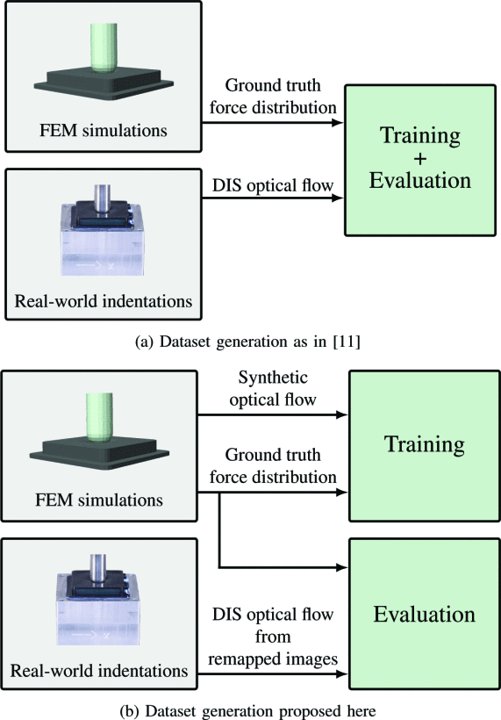
Force Sensor
FEM Simulation
Learning the sense of touch in simulation: a sim-to-real strategy for visionbased tactile sensing
figure a is corresponding to paper "Ground Truth Force Distribution for Learning-Based Tactile Sensing: A Finite Element Approach”
DIS: Dense Inverse Search (Fast Optical Flow using Dense Inverse Search)

Slide 24
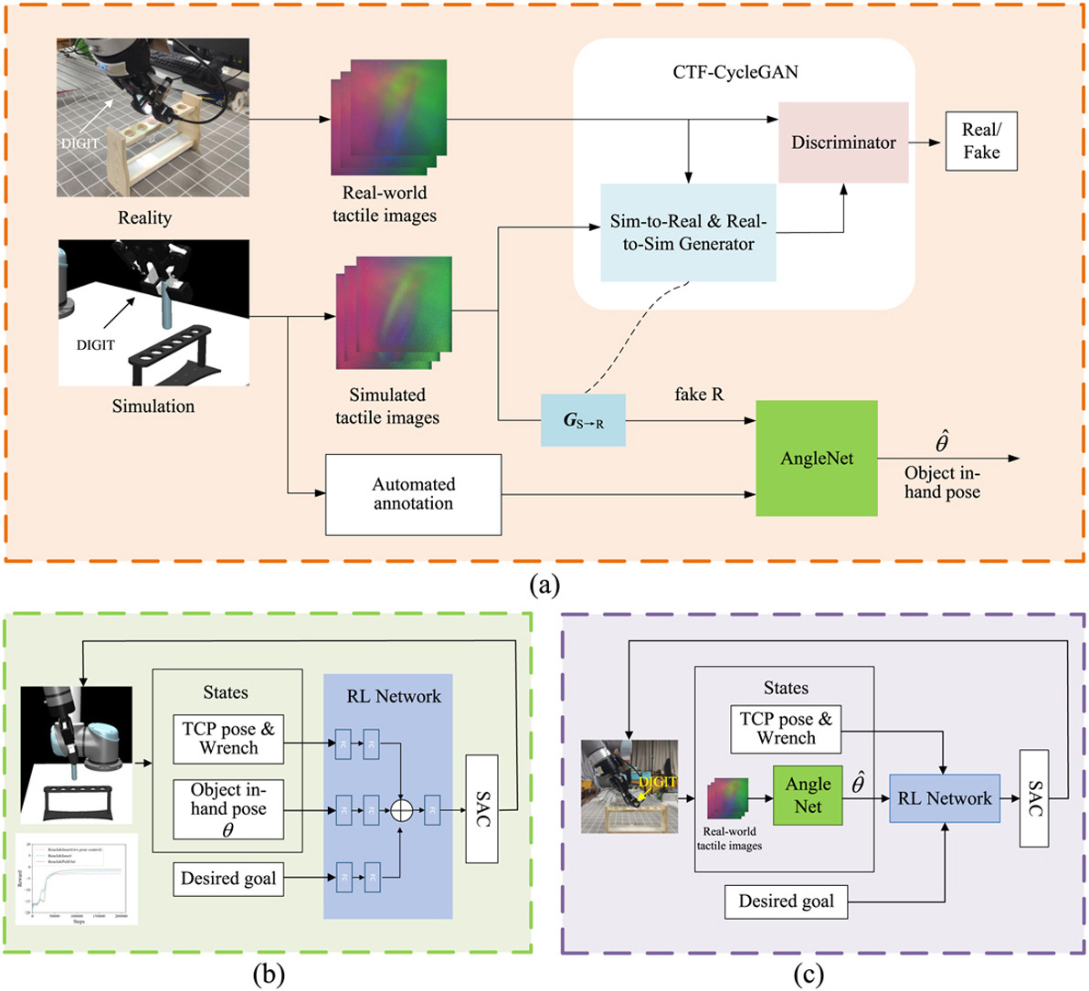
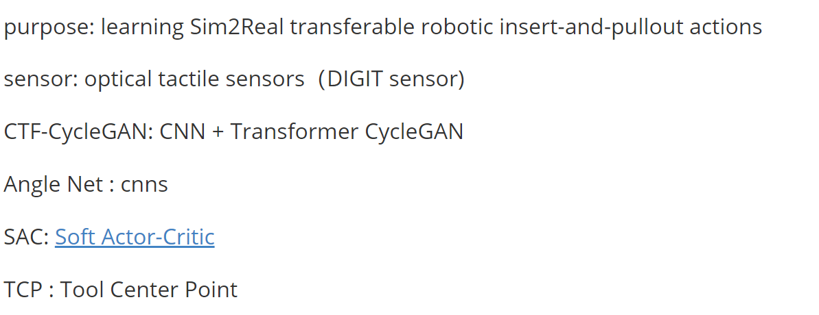
Force Sensor
Simulation Enhancement
Skill generalization of tubular object manipulation with tactile sensing and Sim2Real learning

Slide 25
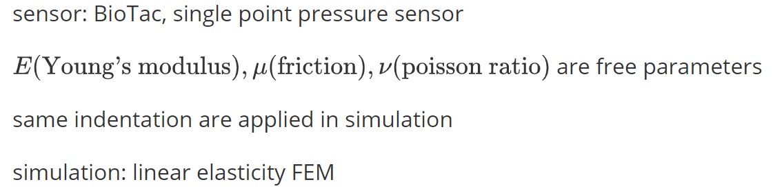
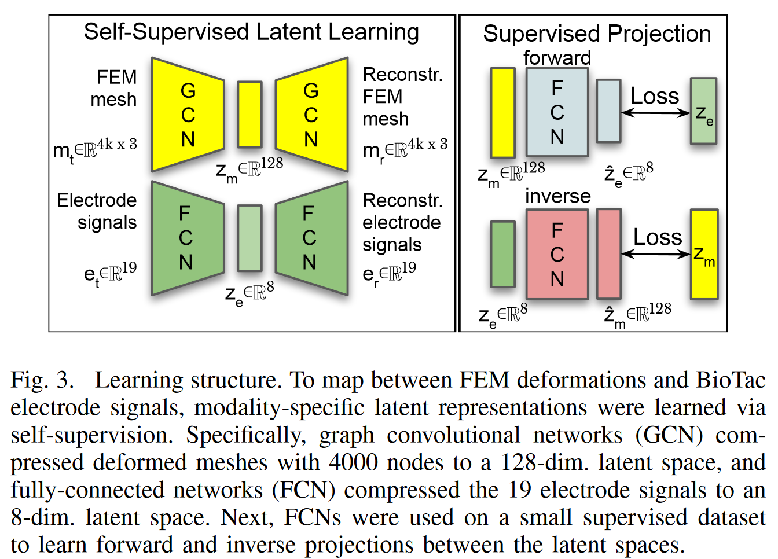
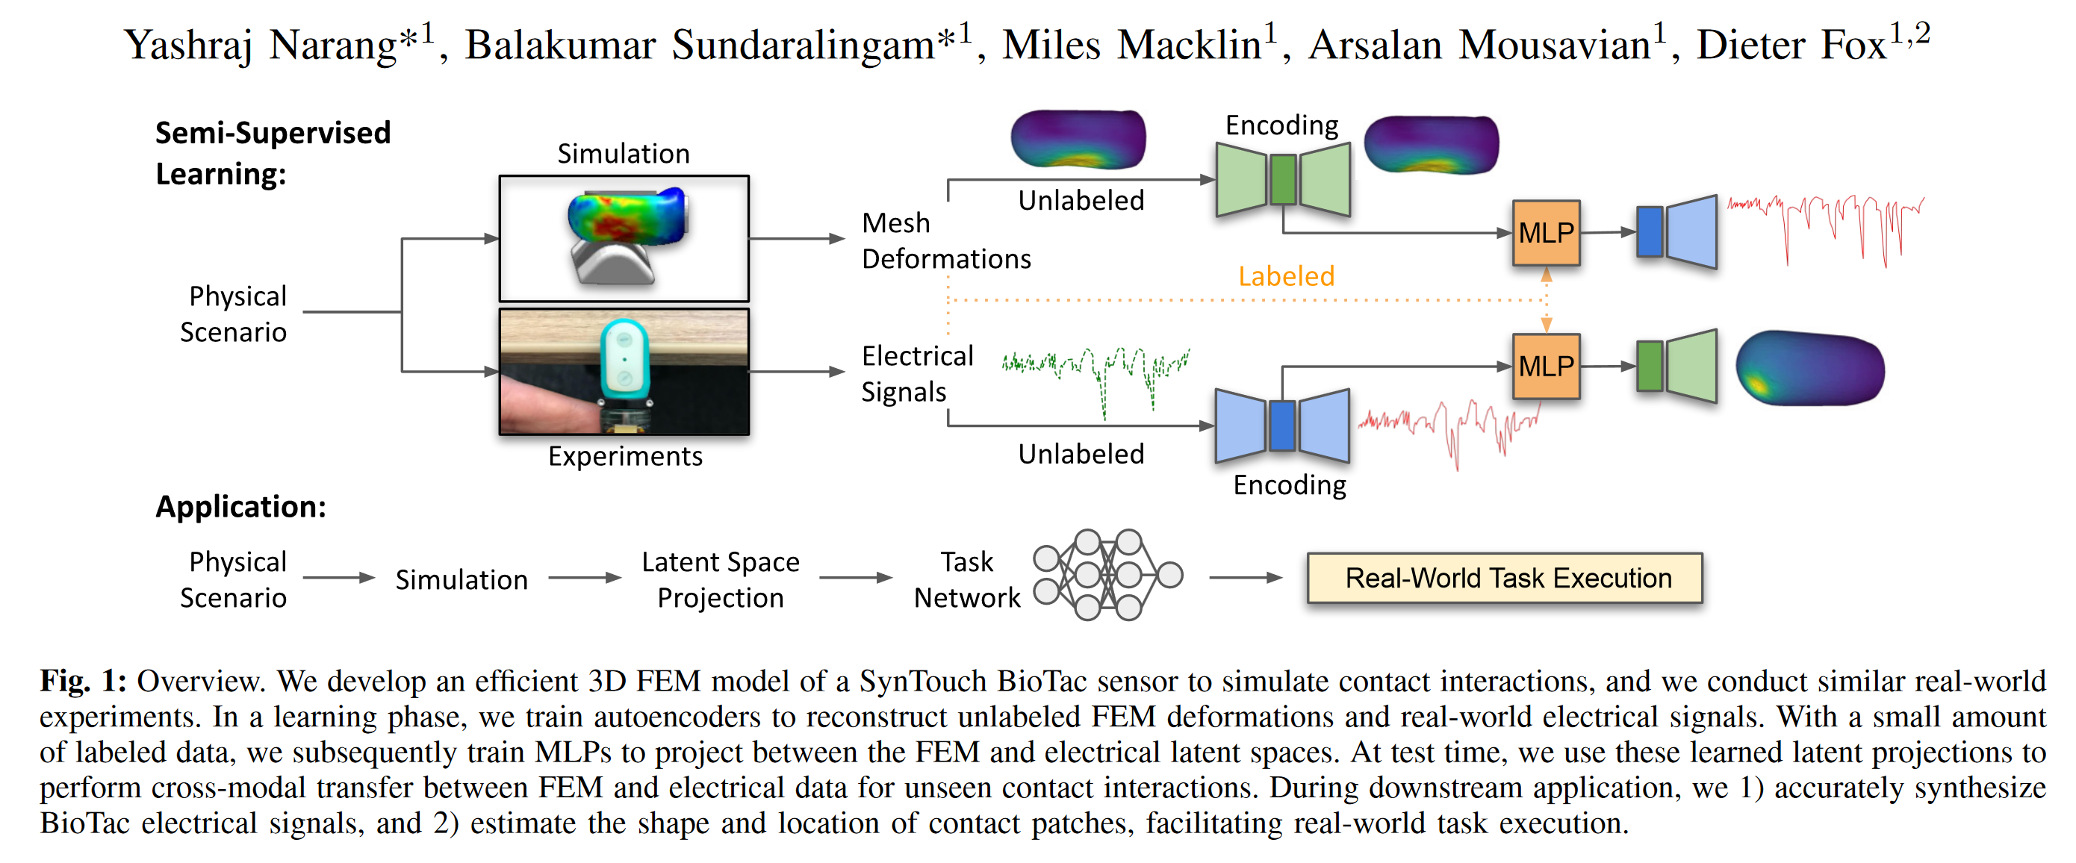
Force Sensor
FEM Simulation
Sim-to-Real for Robotic Tactile Sensing via Physics-Based Simulation and Learned Latent Projections

Slide 26
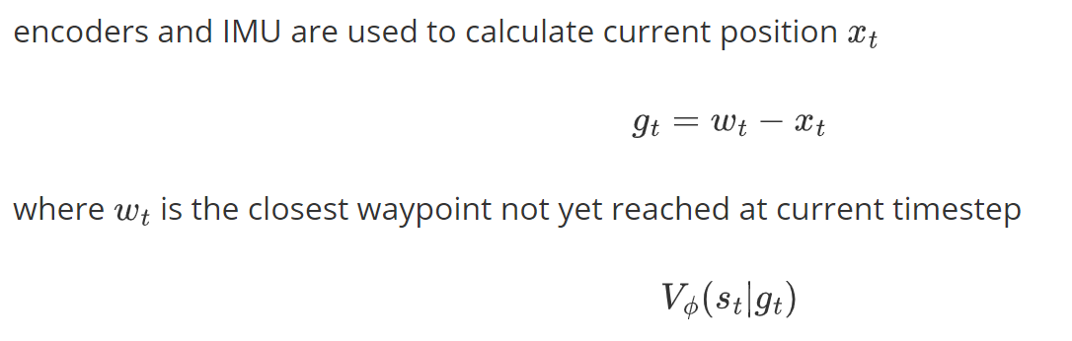
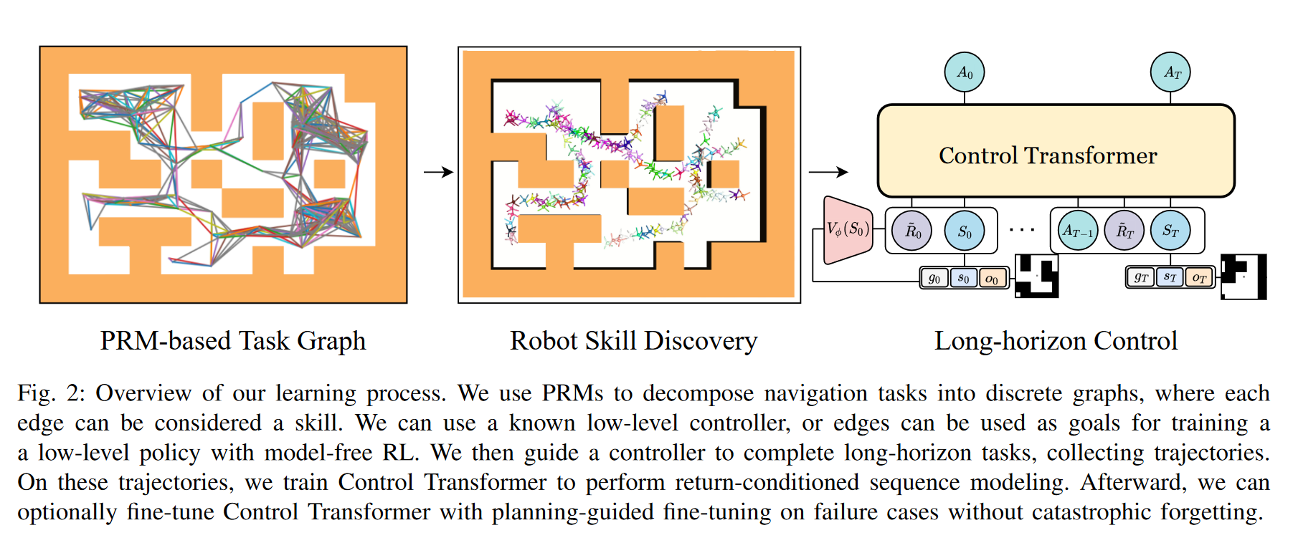
Encoders
Position Esitmation
Control Transformer: Robot Navigation in Unknown Environmentsthrough PRM-Guided Return-Conditioned Sequence Modeling

Slide 27
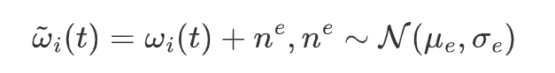
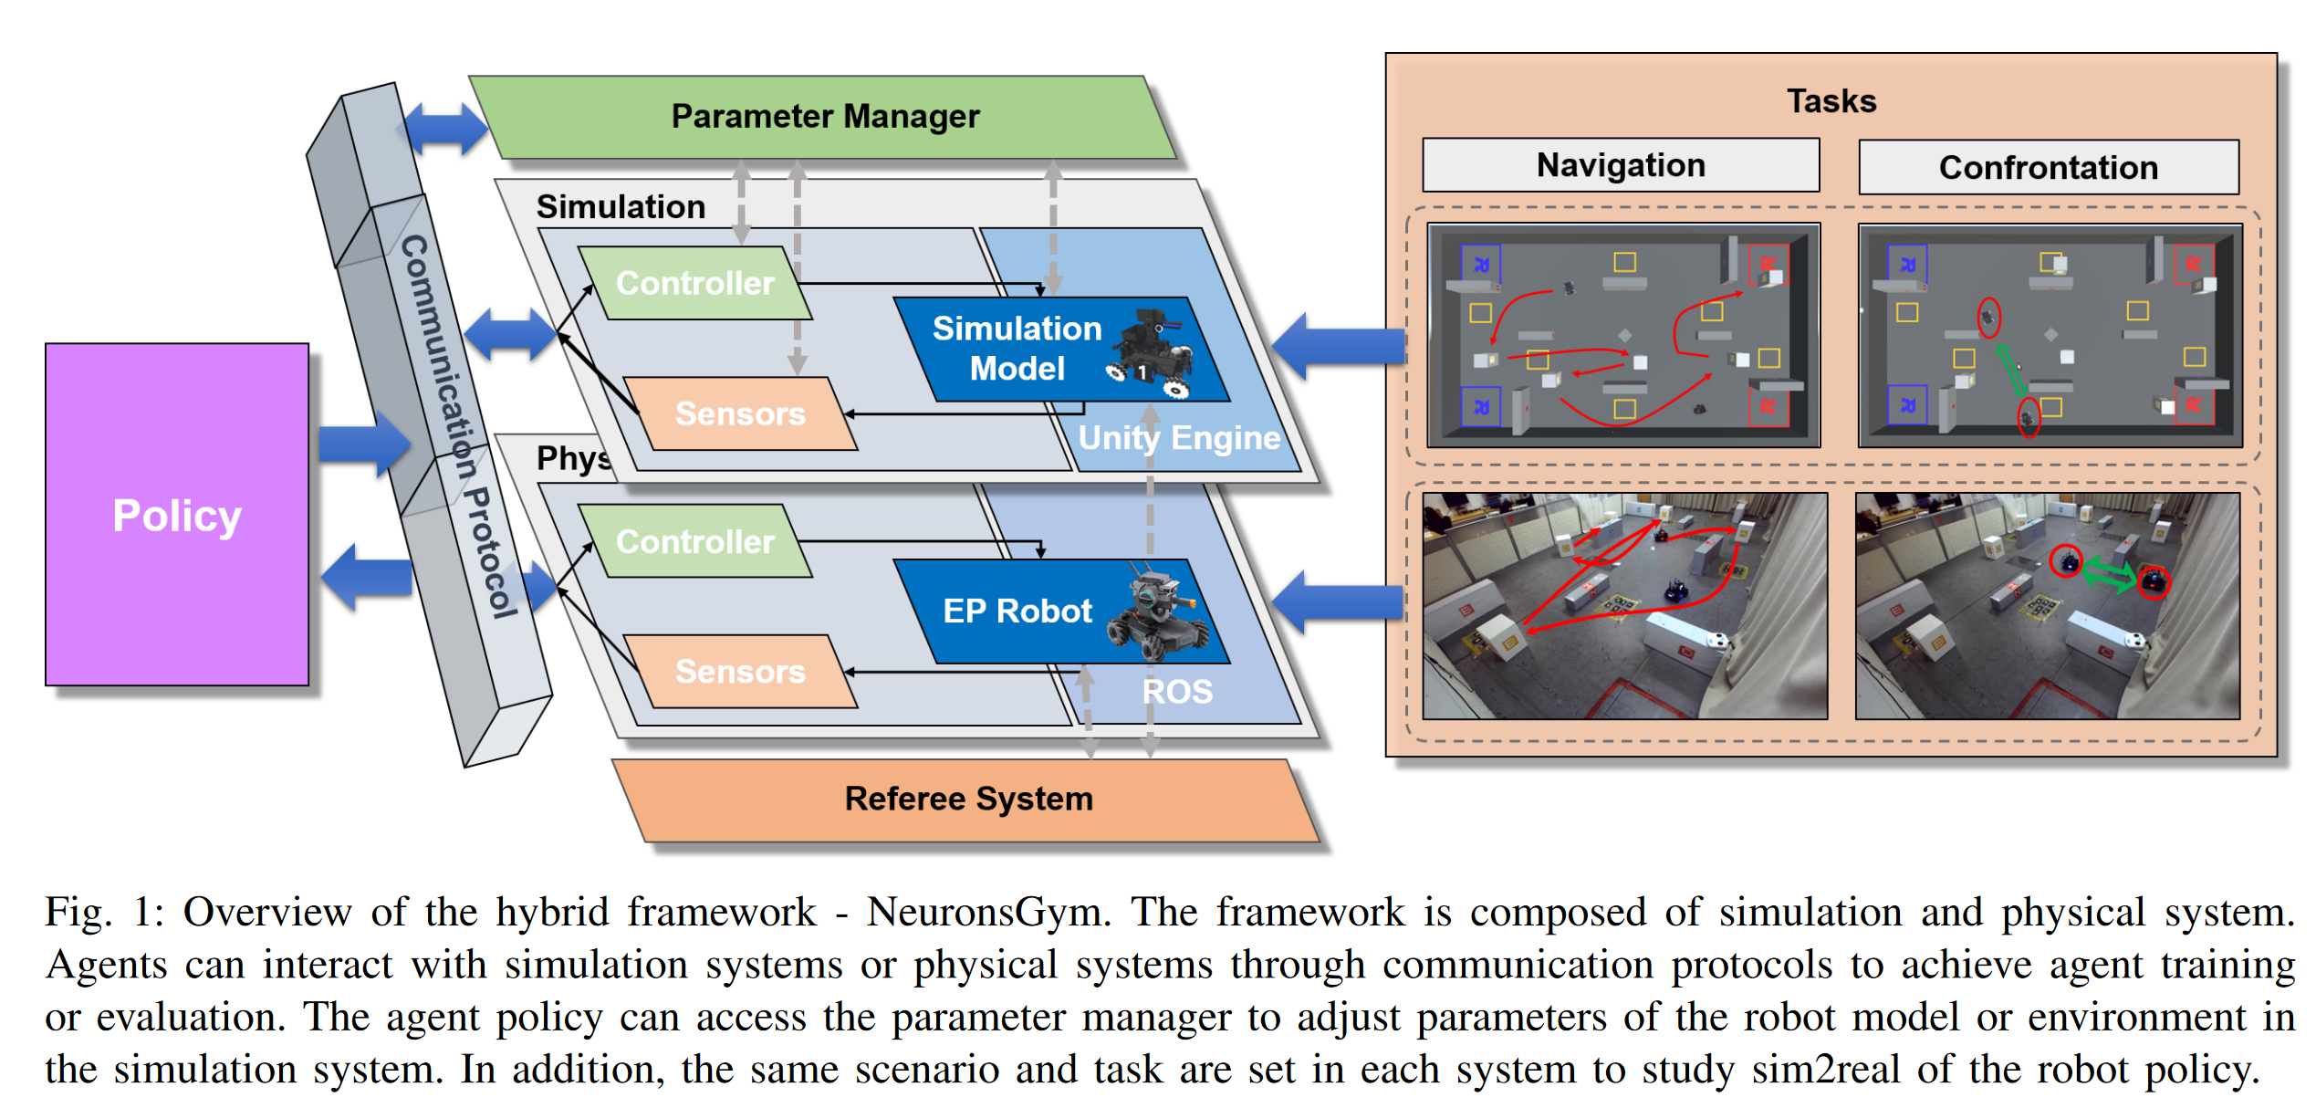
Encoders
Uncertainty Estimation
NeuronsGym: A Hybrid Framework and Benchmark for Robot Tasks with Sim2Real Policy Learning

Slide 28
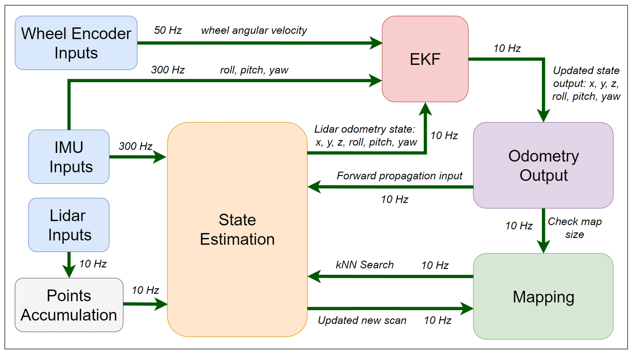
Encoders
Sensor Fusion
LiDAR SLAM with a Wheel Encoder in a Featureless Tunnel Environment
use wheel encoder to correct the LiDAR data, but not related to simulation

Slide 29
Next Week
Add papers/ delete articles according to today’s assesments
Write report draft and send it by email by the end of 5th Dec

